Slide 1



A fully distributed
Clustering Algorithm
based on random walks
Ashutosh Chauhan
S20180010017

Slide 2

Problem Statement
Computer networks tend to grow larger and larger. To manage them, one can consider dividing them into several disjoint connected parts: then each part has to be managed separately and these different parts have to be coordinated.
As a Distributed System the clustering can be initiated by any node and the cluster size should be restricted.

Slide 3
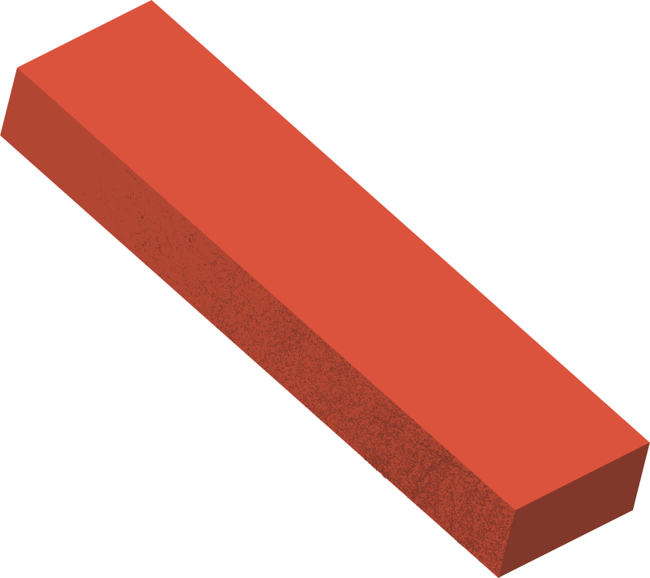
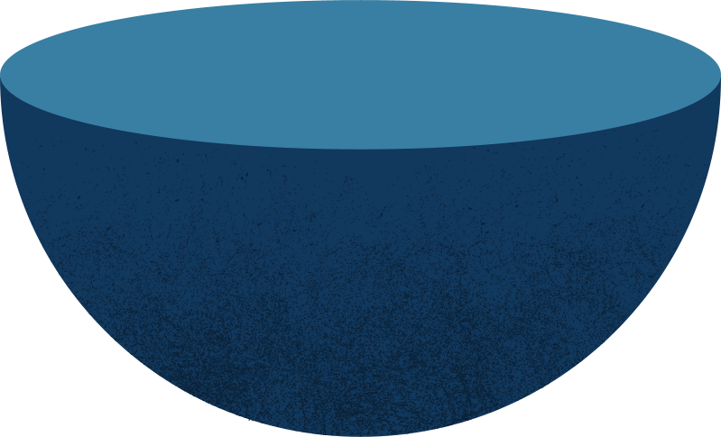
Existing Solutions
Solution 1
Solution 2, 2.1
A Node declares itself as Cluster leader if its the highest among neighbours, or if it is the highest among one of its neighbours neighbours.
Can be used on small networds with size < 100.
DMAC, GDMAC allowed generic weight for Cluster-head election.
Another improvement made it fault-tolerant.
Only allows Single hop clusters.

Slide 4

Proposed Approach

Slide 5
Proposed Approach
Quick-Overview
2 Kind of Nodes
A process starts forming a cluster by sending a Token message to random neighbor to join them into the Cluster Core.
Receiving node can choose to join the cluster (recruiting its neighbors as well) or ignore or return a Delete message when the incoming Token has only a single core member.
Ordering is also added to Messages to prevent deletion of new Cluster Core with same id.
Cluster Core Nodes (Recruits other nodes)
Cluster Member Nodes
3 Kind of Messages
Token{cId, currentSize, id} (to invite a node as Cluster Core)
Recruit (to join as a Member)
Delete (to delete a Single core Cluster)

Slide 6

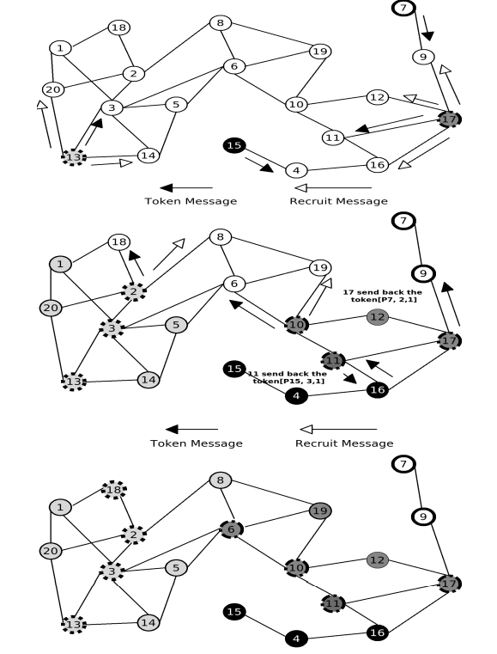
A bit more detailed overview of the Algorithm
We take a graph with 20 nodes with unique ids.
Lets consider some of the nodes start to send Token messages and begin to build the clusters.
The maximal core size is 4 (MaxCoreSize = 4).
We suppose that nodes 13, 15, 17, 7 timers expire first.
Each of them sends a Token message to a neighbor chosen at random.
Node 13 sends Token{P13, 1, 1} to node 3, node 20 sends Recruit messages to all its neighbors of N13
The same procedure for Node 15,17 and 7.
When node 11 receives Token{P15, 3, 1} from node 16, it checks that K11 < MaxCoreSize
Then, Node 11 compares the id of token (P15 > P17) and sends the token back to node 16, and continues to building its cluster with P = 17
Finally we obtain 4 clusters and two of them
are complete

Slide 7
Properties of Algorithm
Cluster Stabilization
Each Node belongs to a Cluster
Cluster Core size lies between 2 and MaxCoreSize
At least one of two Adjacent Clusters will be complete
Cluster is Connected in the steady state

Slide 8
Problems not yet solved
Fault-Tolerance
Topological Changes
Cannot yet take into account the loss of connectivity of the Clusters
Cannot stabilize after changes in topology are made.

Slide 9
Conclusion
The algorithm achieves a lot of great properties along while being independent of topology of the network and also gives a lower bound on the size of majority of clusters that have a more than one neighbor.

Slide 10
References
https://sci-hub.se/https:/ieeexplore.ieee.org/document/5284363

Slide 11
Thank You

